Slide 1


Interworks Skills Test
Calvin Madeley
Technical Solution Discussion

Slide 2
Title
Calvin Madeley
Heading
Subheading
Body

Slide 3
Who am I?
Calvin Madeley
Calvin Madeley
Proven Data Engineering Expertise
Developed complex analytical tools to support business stakeholders
Technical Proficiency
Snowflake, Python (Including data manipulation/visualization libraries), DBT, IICS, Databricks, SQL, and Several BI tools
Dedication to professional development
ITIL, Data Engineering with IICS, Data Science Specialization etc.
Passion for Innovation & AI

Slide 4

Introduction
Calvin Madeley
Background
Summary of Task
Objectives
Data Ingestion & Loading
Data Quality Issues & Cleaning
Data Modelling Approach
Business Value & Takeaways
Closing & Q&A

Slide 5
Background
Calvin Madeley
Task Overview
Ingest, clean, and model domestic flight data from a flat file into Snowflake
Ensure data is structured for business intelligence use in Tableau
Address data quality issues and perform necessary transformation
Key Objectives
Data Ingestion:
Load data into Snowflake
Data Cleaning & Transformation:
Handle missing values, format inconsistencies, and bad data
Dimensional Modelling:
Dimensionally model the data
Business-Ready View:
Develop view on the data ready for integration into Tableu
Data Quality & Integrity:
Standardize values, fix errors, and ensure consistency

Slide 6
Data Ingestion - Overview
Calvin Madeley
Source Data Details
Compressed flat file stored on an external stage
Compressed (.gz), UTF-8 encoded, pipe (|) delimited, first row contains headers
Target
Snowflake environment in candidate schema
Must be able to be integrated into BI tools

Slide 7
Data Ingestion – Data Exploration and Staging of the Data
Calvin Madeley
Data exploration
Raw data loaded into a table
One field (TXT) representing a single line from the csv file
Schema Determined
Field names extracted from the first line
Schema, including datatypes, interpolated from the data
Data Staging
Staging Table created
New database object created from interpolated schema
Data Load
Using the same method used to load the raw data making sure to skip the first (headers) line
Test
Check the data loaded correctly

Slide 8
Data Quality Issues
Calvin Madeley
Extra Information in Columns
AIRLINENAME includes airline codes (e.g., "Southwest Airlines Co.: WN")
ORIGAIRPORTNAME/DESTAIRPORTNAME includes city/state
Inconsistent Categorical Values
CANCELLED/DIVERTED fields have multiple representations
Invalid date formatting
CRSDEPTIME contains 2400 instead of 0000 for midnight
Inconsistent string formatting
TAILNUM contains "UNKNOW“ and inconsistent padding (‘~’, ‘ ‘, and’-’)

Slide 9
Edge cases and Quality Assurance
Calvin Madeley
Edge Cases Considered
Preventing Unknown Value Propagation – Ensured "UNKNOW" values don’t get mistakenly mapped to actual data
Time Data Validation – Ensured transformed times align with business logic
Validation Checks Post-Cleaning
Row Counts before & after transformations to confirm no data loss
Spot Checks on key columns to ensure correct transformations
Summary Statistics (e.g., unique values, null counts) for consistency

Slide 10
Overview of Data Modelling Approach
Calvin Madeley
Key Objectives
Efficient storage and retrieval of data
Support analytical queries by structuring data into Fact & Dimension tables
Optimize for performance and usability
Schema Design Approach
Normalization – Reduces redundancy and improves maintainability
Clear Separation – Fact table for metrics, dimension tables for descriptive attributes
Optimized View – Ensures ease of access for business users

Slide 11
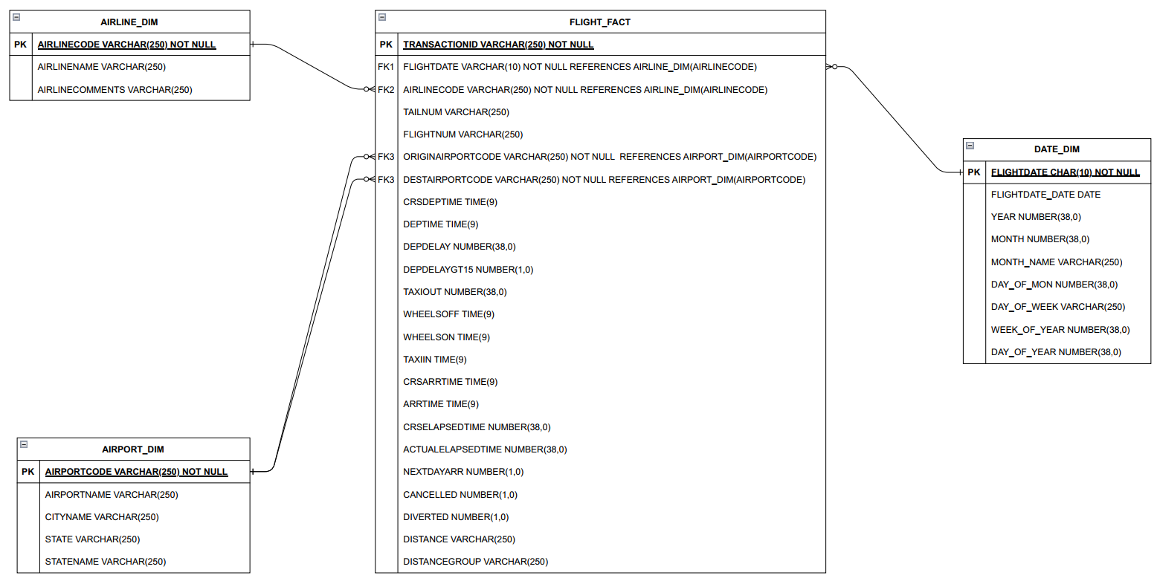
Data Model
Calvin Madeley

Slide 12
Fact Table
Calvin Madeley
FACT_FLIGHTS (Core Flight Metrics)
Stores key flight-related measures:
Flight details: eg:
Planned flight date and departure time
Actual departure time
Distance travelled
Synthetic key of dimension tables
Derived fields:
DISTANCEGROUP: Categorizes flights by distance
DEPDELAYGT15: Boolean flag for flights delayed > 15 min
NEXTDAYARR: Indicates if arrival happened the next day

Slide 13
Dimension Tables
Calvin Madeley
Dimension tables
DIM_AIRPORT: Airport details, used for arrival and departure airport:
AIRPORTCODE
AIRPORTNAME
CITYNAME
STATE
STATENAME
DIM_AIRLINE: Airline details
AIRLINECODE
AIRLINENAME
AIRLINECOMMENTS
DIM_DATE: Date-based attributes
FLIGHTDATE
DAY_DATE
YEAR“
MONTH“
MONTH_NAME
DAY_OF_MON
DAY_OF_WEEK
WEEK_OF_YEAR“
DAY_OF_YEAR
Why?
Improves query performance by reducing duplication
Enhances readability by keeping descriptive attributes separate

Slide 14
Approach Justification
Calvin Madeley
Normalization Improves Maintainability
Reduces duplication – FACT_FLIGHTS stores IDs instead of full names
Easier updates – Changing an airline name in DIM_AIRLINE updates everywhere
Clear Separation of Concerns
FACT_FLIGHTS → Stores measurable event data
DIM_ Tables → Store descriptive attributes
Optimized for Business Users
VW_FLIGHTS simplifies reporting
Ensures fast query performance
Reduces complexity for non-technical users

Slide 15
Business Value and Key Challenges
Calvin Madeley
Business Value
Clean, Structured Data – Ensures accurate and consistent reporting
Improved Query Performance – Dimensional modeling optimizes retrieval speed
Seamless BI Integration – Pre-joined VW_FLIGHTS simplifies BI integration
Scalability & Maintainability – Easier to extend with new dimensions or metrics
Reduces duplication – FACT_FLIGHTS stores IDs instead of full names
Key Challenges Overcame
Data Extraction – Data originally stored in external store
Data Load – Source data needed to be understood before loading into a raw data staging table
Data Translation – Challenges with data quality and consistency needed to be overcame such as:
Concatenated airport information
Concatenated airline information
Malformed data
Data Inconsistencies
Data Modelling – Raw data inadequate for use in a properly managed enterprise database solution
Data needed to be loaded into a dimensional model
A view on the model needed to be generated for integration with business processes
Object Suitability – The project scope mentioned Tableau integration
Final view needed to be tested to ensure that it was fit for purpose within the scope of this project

Slide 16
Additional Considerations
Calvin Madeley
Pipeline creation
Proposed solution is adequate for an ad-hoc data ingestion task however, if this were a process that were to be automated and scheduled, additional considerations would need to be made
If the quantity of data to be loaded remains small, and the rate of data generation remains manageable a full load would be appropriate
Incremental load of the data involves additional overhead but would result in more efficient resource use in larger data load operations
If historical data is not static, but a record of historical data needs to be preserved a time variable load pattern could be implemented where the entirety of the data is loaded each time but with a load date and current flags are used to denote the most recently loaded data
The solution would need to be compatible with the existing enterprise data environment, for example, in a hybrid environment the raw data might be loaded into an external table first

Slide 17
Thank you
Calvin Madeley
Thank you for taking the time to meet with me today
Any Questions?

